Slide 1


Mortality Prediction in ICU with RNN
Team 27:
Baolin Wang, Shimiao Zhang, Jiawei Zhu

Slide 2
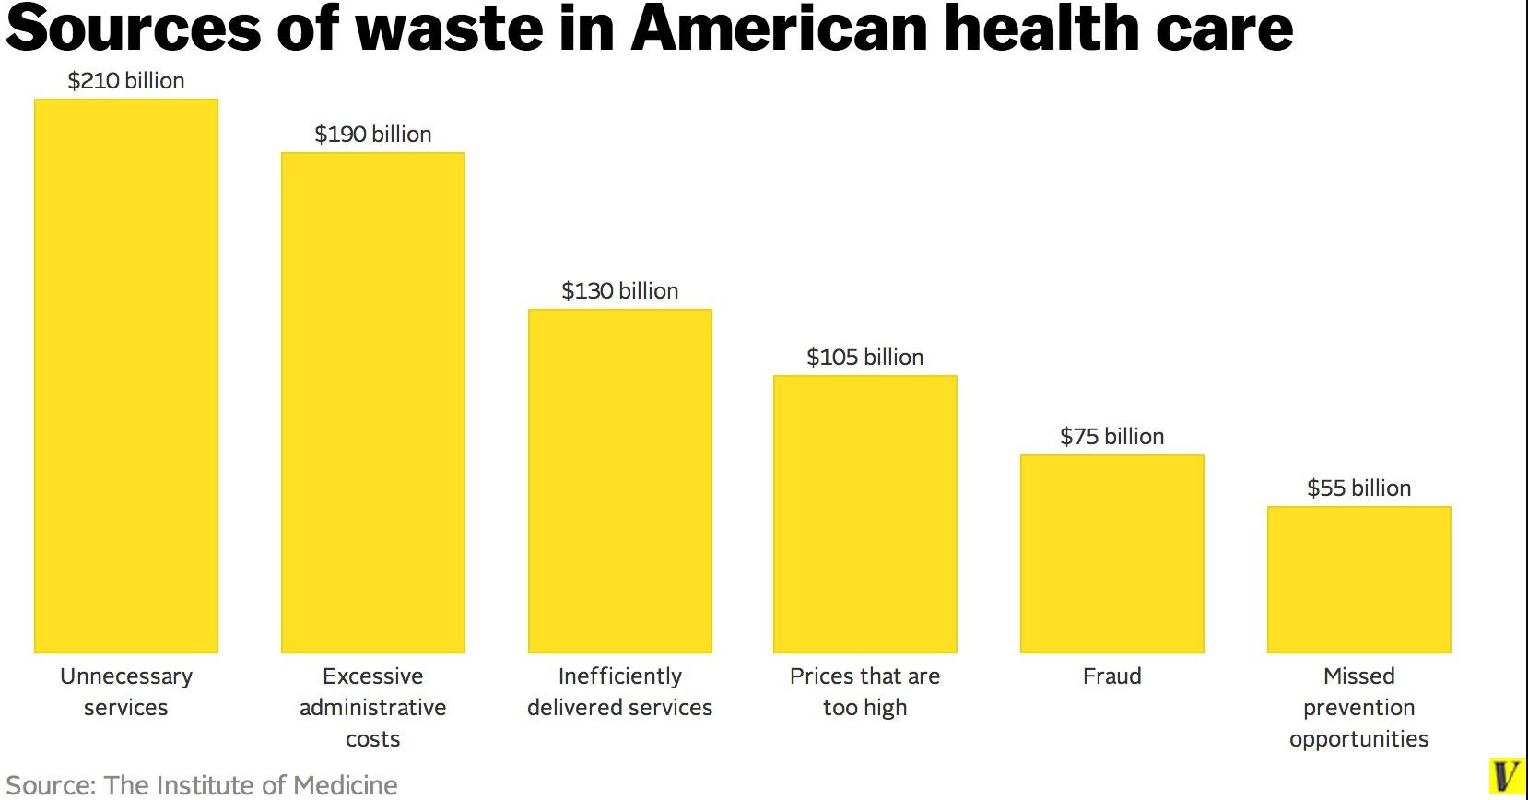
Motivation
High annual waste cost in healthcare system in US: $750 Billion
Implement machine learning models to predict in-hospital mortality
Improve efficiency and quality of health care

Slide 3
Dataset - MIMIC III
MIMIC-III (Medical Information Mart for Intensive Care III)
A public dataset with clinical care data consisting of over 40,000 patients who stayed in critical care units between 2001 and 2012
contains information regarding medications, imaging reports, mortality, procedures, laboratory test results, caregiver notes, etc
What we need: data related to ICU stays, admissions, diagnoses, prescriptions, and lab results.

Slide 4
Approach
Predictive model
Recurrent Neural Network (RNN) for time series data
Evaluation metrics
AUROC

Slide 5
Software and environment
Apache Spark (2.4.0)
Computations of statistics of the datasets and extraction
Construction of the features
PyTorch (1.0)
Python (3.7)
Build and evaluate our RNN model

Slide 6
Data Preprocessing
Table 1. Fields of the datasets used for feature construction
Datasets | Fields
Admissions | subject_id: String, hadm_id: String, admittime: String
Daignose_icd | subject_id: String, hadm_id: String, icd9_code: String
Icustays | subject_id: String, hadm_id: String, icustay_id: String, los: Double
Labevents | subject_id: String, hadm_id: String, itemid: String, valuenum: Double
Patients | subject_id: String, is_dead: Boolean
Prescription | subject_id: String, hadm_id: String, drug: String
Training: 65 %
Testing: 20 %
Validation: 15 %

Slide 7
Feature Construction
Potential features
diagnostic icd9 code, medications, lab results, length of ICU stay
Different combinations of features
Diagnostic features: 1044
Diagnostic features + length of ICU stay feature: 1045
Diagnostic features + length of ICU stay feature + lab result features: 1516
All features: 4856
Choose all features
AUC: 0.90
false positive rate: 0.44
false negative rate: 0.05

Slide 8
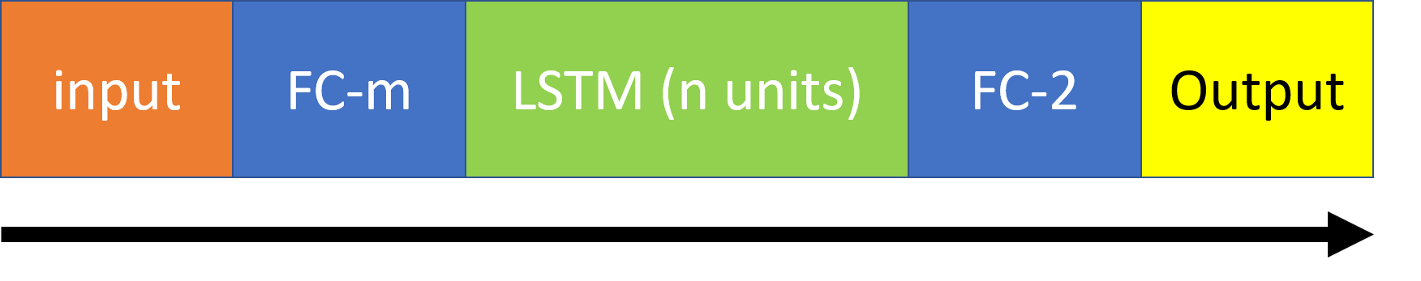
Model
Table 2. Parameters used for the best model.
Parameters | Values
Hidden Layers in the First FC Layer m | 64
Hidden Units in the LSTM Layer n | 16
Hidden Layers in the Second FC Layer | 2
Learning Rate | 0.007
L2 Penalty | 0.0004
Batch Size | 64
Training Epochs | 50
FC layer: fully-connected layer .
The first FC layer act as an embedding layer.

Slide 9
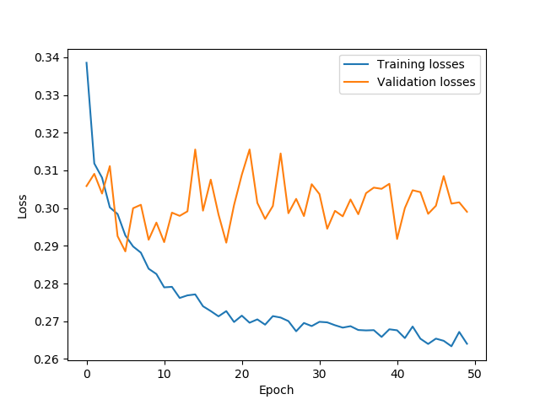
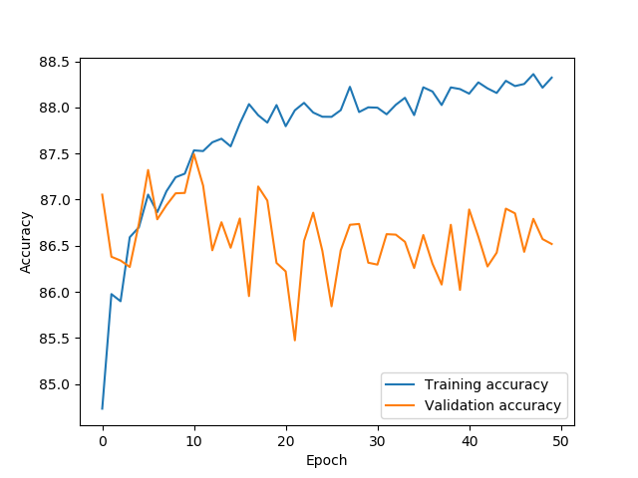
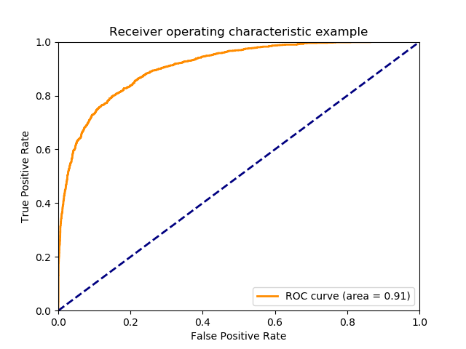
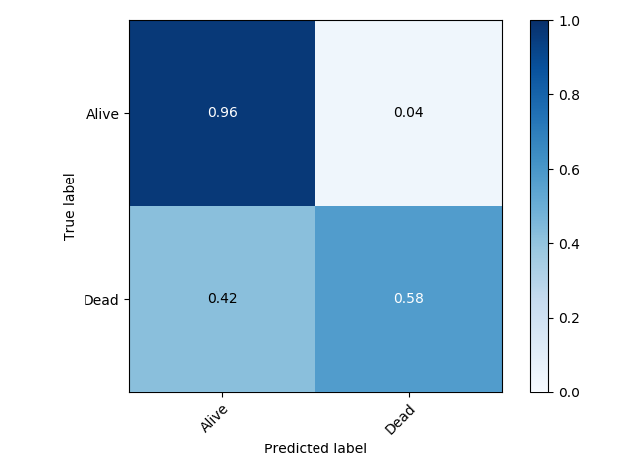
Results
a
b
The best accuracy for the validation dataset is 0.875
The AUC score for the test dataset is as high as 0.91.
c
d
Figure 2. Results for the best model developed in this work. (a) curve of accuracy verse epoch; (b) curve of loss verse epoch;.(c) ROC curve; (d) confusion matrix;

Slide 10
Reference
[1] https://hcldr.wordpress.com/2018/07/15/wasted-healthcare-spending-a-750-billion-opportunity
[2] Johnson, A.E., Pollard, T.J., Shen, L., Li-wei, H.L., Feng, M., Ghassemi, M., Moody, B., Szolovits, P., Celi, L.A. and Mark, R.G., 2016. MIMIC-III, a freely accessible critical care database. Scientific data, 3, p.160035.

Slide 11
Thanks for your attention!

